Slide 1

HOTEL RESERVATION & CANCELLATION PREDICTION
-DADI VASANTHI (119EC0018)

Slide 2
PROBLEM STATEMENT
Given a dataset containing data of reservations made by customers in different hotels, build a machine learning model to predict whether the customer cancels his/her hotel reservation or not.

Slide 3
process
Data cleaning
encoding
Training models

Slide 4
dataset
No. of rows = 119390
No. of attributes = 32
Target variable = is_canceled
No. of independent variables = 31
No. of numeric variables = 12
No. of object variables = 19

Slide 5
INDEPENDENT VARIABLES IN DATASET
is_repeated_guest
previous_cancellations
previous_bookings_not_cancelled
reserved_room_type
assigned_room_type
booking_changes
deposit_type
agent
total_of_special_requests
adr
Hotel
Lead_time
Arrival_date_year
Arrival_date_month
Arrival_date_week_number
Arrival_date_day_of_month
Stays_in_weekend_nights
Stays_in_week_nights
required_car_parking_spaces
customer_type
company
Adults
Children
Babies
Meal
Country
Market_segment
Distribution_channel
reservation_status_date
reservation_status
days_in_waiting_list

Slide 6
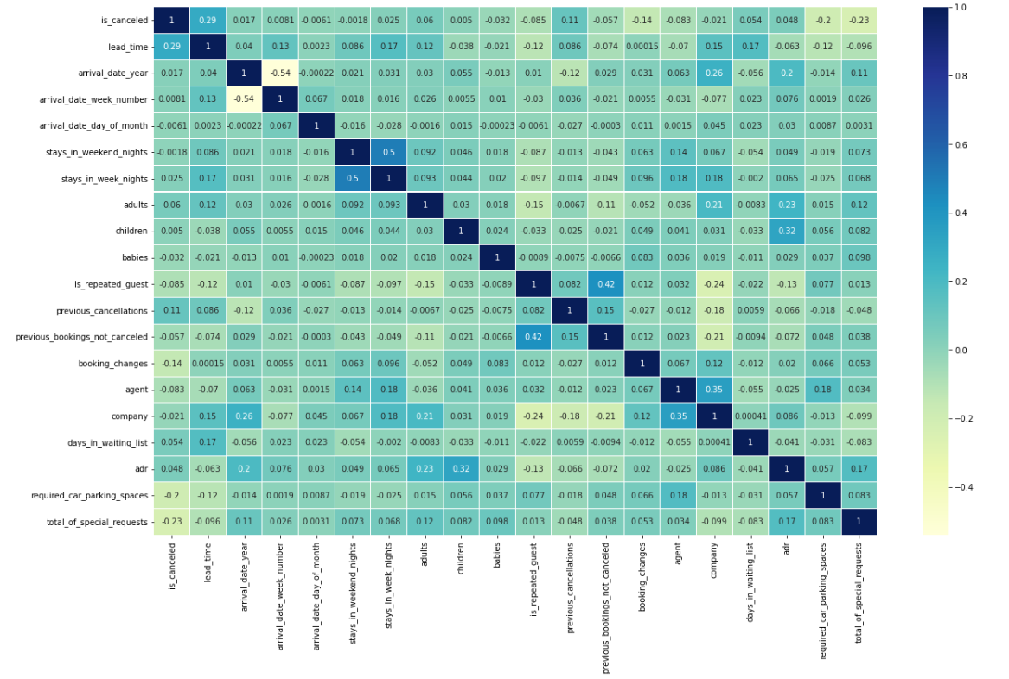
Correlation matrix

Slide 7

DATA CLEANING
Data cleaning is the process of preparing data for analysis by removing or modifying data that is incorrect, incomplete, irrelevant, duplicated, or improperly formatted.
REPLACING NULL/MISSING VALUES
1. Replacing numerical missing values with mean/median
2. Replacing categorical missing values with mode
REMOVING DUPLICATE VALUES

Slide 8
REPLACING NULL/MISSING VALUES
Replacing numerical missing values with mean/median
Replacing categorical missing values with mode
Number of null values in [children] = 4
Number of null values in [agent] = 16340
Number of null values in [company] = 112593

Slide 9
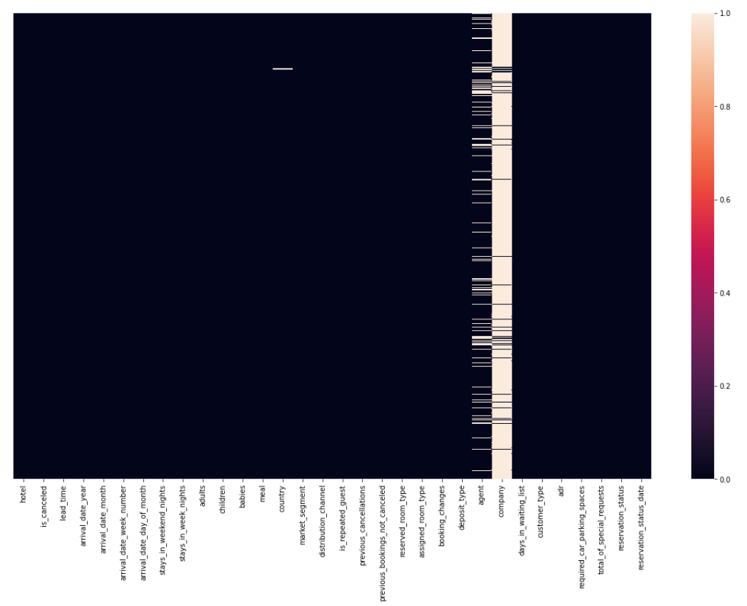
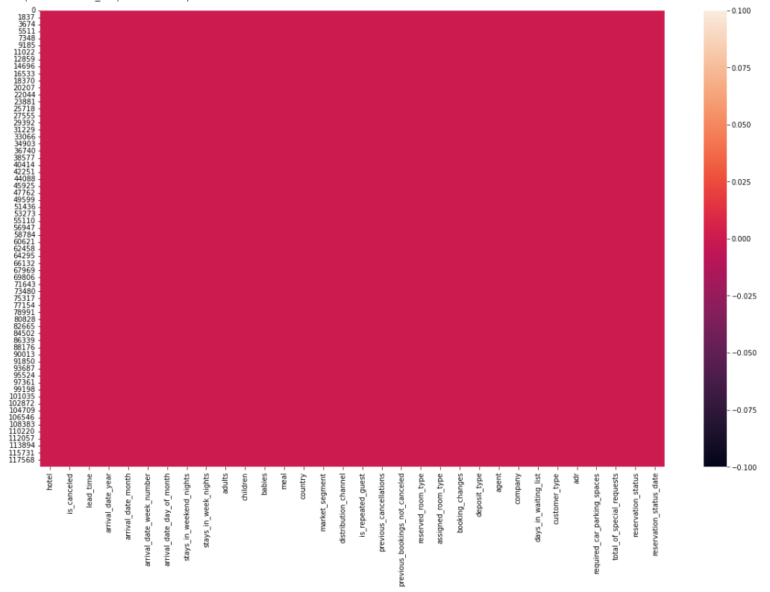
Before and after replacing null values

Slide 10
REMOVING DUPLICATE VALUES
Number of duplicate values in the data set = 32013
In order to obtain only distinct records, We will eliminate the 32013 duplicate records from the data set. After eliminating the duplicate values, we will verify whether the duplicates were eliminated from the data set or not.
Number of rows in the dataset after removing duplicates = 87377

Slide 11
ENCODING CATEGORICAL DATA
Encoding categorical data is a process of converting categorical data into integer format so that the data with converted categorical values can be provided to the different models.
An approach to encoding categorical values is to use a technique called label encoding. Label encoding is simply converting each value in a column to a number.
This type of encoding is used when the variables in the data are ordinal, ordinal encoding converts each label into integer values and the encoded data represents the sequence of labels.

Slide 12
Categorical variables in dataset
Hotel
arrival_date_month
meal
country
Market_segment
distribution_channel
reserved_room_type
assigned_room_type
deposit_type
customer_type
reservation_status
reservation_status_date

Slide 13
Training the model
Size of training data = 80%
Size of testing data = 20%

Slide 14
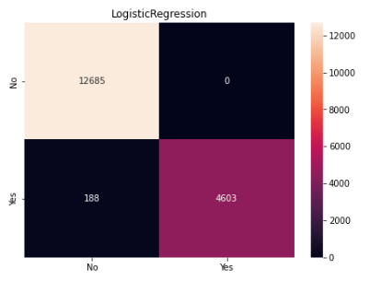
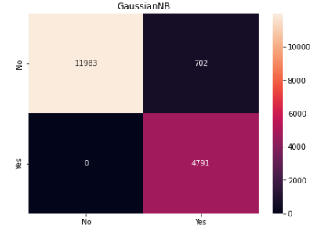
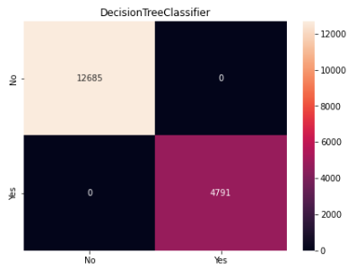
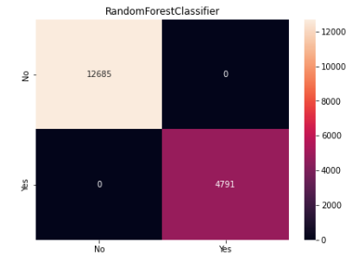
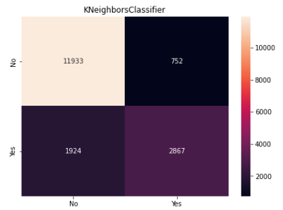
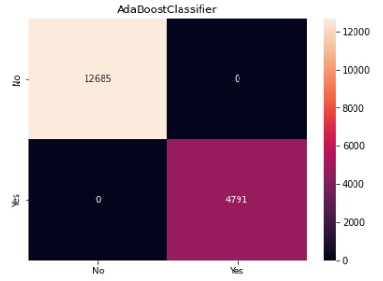
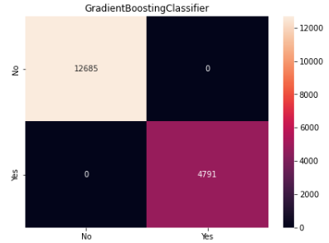
CONFUSION MATRIX

Slide 15
Accuracy using various classifiers
Logistic Regression:
Training accuracy: 0.9881546758987712
Testing accuracy: 0.9892423895628291
Gaussian NB:
Training accuracy: 0.9601722436016652
Testing accuracy: 0.9598306248569467
Kneighbors Classifier:
Training accuracy: 0.8943505815367448
Testing accuracy: 0.8468757152666514
DecisionTree Classifier:
Training accuracy: 1.0
Testing accuracy: 1.0
Random Forest Classifier:
Training accuracy: 1.0
Testing accuracy: 1.0
Ada Boost Classifier:
Training accuracy: 1.0
Testing accuracy: 1.0
Gradient Boosting Classifier:
Training accuracy: 1.0
Testing accuracy: 1.0

Slide 16
conclusion
The highest accuracy in this problem is obtained using the Decision Tree Classifier, Random Forest Classifier, Ada Boost Classifier, and Gradient Boosting Classifier
Highest accuracy = 100%

Slide 17

Thank You

